Slide 1
W4111 – Introduction to Databases Section 002, Spring 2021
© Donald F. Ferguson, 2021

Slide 2

COMS W4111: Introduction to Databases, Section 002, Spring 2021
Lecture 1: Introduction, Course Overview, Foundational Concepts
Donald F. Ferguson (dff@cs.columbia.edu)
© Donald F. Ferguson, 2021

Slide 3

We will start in a couple of minutes
3 | COMS W4111_002_2021_1: Lecture 1: Introduction, Course Overview, Foundational Concepts © Donald F. Ferguson, 2021

Slide 4
Contents
4 | COMS W4111_002_2021_1: Lecture 1: Introduction, Course Overview, Foundational Concepts © Donald F. Ferguson, 2021

Slide 5
Contents
Introduction
Logistics, about your instructor, OHs, TAs.
Homework, exams.
Target application/solution/project.
Core concepts
Motivating examples (Gives you a feel for programming and non-programming projects).
Introductory concepts: data, databases, database management systems.
Application, application architectures, roles.
Database design, Entity-Relationship Model (Part 1)
Database design process.
ER-Model and diagrams.
The theory: The Relational Model (Part 1)
Relational model, schema, keys, schema diagrams.
Basics of relational algebra.
The realization: Structure Query Language (SQL) (Part 1)
Basics of Data Definition Language.
Basics of Data Manipulation Language (Query).
Homework 0 – Definition and discussion.
Read chapter 1 slides.
Will cover in recitation.

Slide 6
Introduction
Logistics
Exams, Homework
6 | COMS W4111_002_2021_1: Lecture 1: Introduction, Course Overview, Foundational Concepts © Donald F. Ferguson, 2021

Slide 7
Waitlist
The administrative staff of the Dept. of Computer Science directly manages enrollment in the W4111 sections and the wait lists.
COMS W4111 is ALWAYS oversubscribed and has huge wait lists.
The course is a requirement for several majors and tracks.
There are complex rules about prioritizing students for course enrollment, and also which students can take the hybrid section.
Section 002, Spring 2021 is like all sections of W4111, but has some emphasis on supporting students in Data Science Institute.
In place of required COMS 4121, which is not taught this year.
DSI students have first priority, followed by CS Dept. prioritization for enrollment.
Faculty follow department policies and do not manage waitlists, despite the list that identifies the waitlist as “Instructor Managed.”
Contacts: You must work with administrative leaders on enrollment:
Computer Science: Cynthia Meekins, cynthia@cs.columbia.edu)
Data Science Institute: Brianne Cortese (bc2640@columbia.edu)

Slide 8
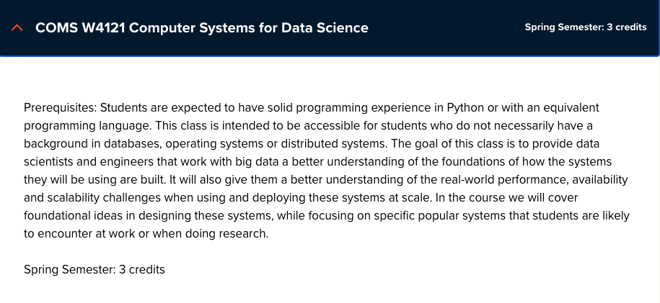
A Comment about this Section
The department has trouble offering W4121
W4121 is a requirement for M.S. in Data Science.
The DSI and CS Dept. have been substituting
W4111 for
W4121
The CS Dept. asked me to prioritize my section for M.S. in Data Science students.
I will try to adapt the syllabus to support:
CS students.
Non-CS students.
DSI students.
If you are a DSI student, there will be content that I tailor to have W4111 better meet your needs.
If you are not a DSI student, you will get the same benefits from this section as previous versions of W4111 that I taught.

Slide 9

About your Instructor
35 years in computer science industry:
IBM Fellow
Microsoft Technical Fellow.
Chief Technology Officer, CA technologies.
Dell Senior Technical Fellow.
CTO, Co-Founder, Seeka.tv.
Ansys Fellow
Academic experience:
BA, MS, Ph.D., Computer Science, Columbia University.
Approx. 15 semesters as an Adjunct Professor.
Professor of Professional Practice in CS (2018)
Courses:
E1006: Intro. to Computing
W4111: Intro. to Databases
E6998, E6156: Advanced Topics in SW Engineering (Cloud Computing)
Approx. 65 technical publications; Approx. 12 patents.
Personal:
Two children:
College freshman (Ithaca College).
2019 Barnard Graduate.
Hobbies:
Krav Maga, Black Belt in Kenpo Karate.
1LT, New York Guard.
Bicycling.
Astronomy.
Languages:
Proficient in Spanish.
Learning Arabic.

Slide 10
The Course
From the new/pending Columbia University Bulletin "Prerequisites: COMS W3134, COMS W3136, or COMS W3137; or the instructor's permission. The course covers what a database system is, how to design databases effectively and in a principled manner, how to query databases, and how to develop applications using databases: entity-relationship modeling, logical design of relational databases, relational algebra, SQL, database application development, database security, and an overview of query optimization and transaction processing. Additional topics generally include NoSQL, graph, object-relational, and cloud databases, as well as data preparation and cleaning of real-world data. The course offers both programming and non-programming paths for homework and projects, to accommodate students with different programming skills and backgrounds."
Prerequisites:
COMS W3134, COMS W3136, or COMS W3137 are data structures classes. All of these courses require extensive programming, in Java.
A course in data structures is helpful for this section of W4111 but not essential. I waive the requirement.
We will help you with any data structures knowledge you lack.
Programming in/for this class:
There will be a "non-programming" option, which we will discuss below.
For students who want to take the programming track, we will use Python. I will provide motivation for choosing Python below.

Slide 11
Lecture Format, Recitation, Office Hours
Lecture: Friday, 10:10 to 12:40 – This is a hybrid section, like many classes this fall.
The in-person lectures are optional. I encourage you to attend in-person if you are on campus.
I will hold as many lectures in-person as possible but may hold some lectures online only.
I will announce in advance if I plan to hold a lecture online only.
Lectures are streamed and recorded.
Students can attend in-person, watch the stream or watch the recording. These options are available to all students.
There are limitations on how many students can attend in person due to social distancing. I will provide a sign-up method to reserve seats if necessary.
Recitation: Optional recitation on Saturday, 10:00 to 11:30.
Either in-person/online or just online. Will announce in advance.
Will hold when there is student interest, homework due, exams, etc.
Office hours: (Friday: 0830 to 1000, 1300-1400; and by-request as needed)
I will hold on-campus and online offices hours. There will be online office hours that accommodate all time zones.
I will be on campus when possible for students that want to speak with me or need more focused help.
I will publish in-person OH when I plan them.
I will provide a sign-up mechanism for in person office hours if necessary.
Note: Your health, safety and well-being are ALWAYS my primary concern. These are bizarre, stressful times. Speak to me if you need special considerations and I will do the best that I can.

Slide 12
Assignments, Exams, Grading
Point value of assignments and exams
50%: Homework assignments:
4 HWs, approximately one HW every two-three weeks.
Each is worth either 10 or 15 points based on difficulty..
Homework format:
Common to all tracks:
Questions requiring written answers and diagrams.
Implement/execute/test of various database operations required to solve a use case/question.
Format will be an iPython/Jupyter Notebook.
Track specific: Incremental development of a project:
Programming track – web application.
Non-programming track – data analysis/visualization.
Exams: Take home, the same for all tracks.
20% of grade is midterm exam score.
30% is final exam score.
97-100 points is an A. There are opportunities to get extra-credit.
All tracks will learn core concepts and get experience with other tracks’ focus topics.

Slide 13
The Course – Value and my Perspective
This course is foundational, and will teach you the core concepts in
Data modeling
Data model implementation; Data manipulation.
Different database models and database management systems.
Implementation and architecture of data centric applications and database management systems.
ANY non-trivial application
Requires a well-designed data model.
Implements a data model and manipulates data.
Uses a database management system.
Understanding databases and database management is core to the “hottest fields” in computer science, e.g.
Data science
Machine learning
Intelligent (Autonomous) systems
Internet-of-Things
Cybersecurity
Cloud Computing
Database, database application, etc. skills are increasingly central to many disciplines, including:
Economics.
IEOR, financial engineering.
Mechanical and electrical engineering.
Medicine, pharmaceuticals
...
University courses on databases sometimes focus on theory and abstract concepts. This course will cover theory, but there will be an increased emphasis on:
Practical, hands-on applications of databases.
Patterns and best practices.
Developing and understanding database centric applications.
Using databases and various tools for data analysis, visualization and insight.
Personal perspective
A large percent of my career has been spent figuring out or leading teams that figured out how to model, implement and manipulate data.
I have used the information in this class more than anything else I have learned.
This will likely be true for you.

Slide 14
Surprising Example
Example: This is a photo of mean using a database during COVID-19 mobilization.
Match service members
To JTF-HQ requests for personnel
Based on assignment needs
And service member
Skills
Availability
Tracked in a DBMS.
The hardhat is because DB usage can be very dangerous 😱.
No joking: I had to build an application that used:
Relational DBMS.
Python, Jupyter Notebook.
Google Sheets with Apps Script.
Google Forms.
This technology and these skills are surprisingly applicable.

Slide 15
Basic Course Logistics
Lecture: Friday, 10:10 AM-12:40 PM, Room TBD
Instructor: Donald F. Ferguson (dff@cs.columbia.edu)
Office Hours:
Fridays: 8:30 AM - 10:00 PM, 1:00 - 2:00 PM (Location TBD; in-person and online)
By appointment, as needed, as available.
I hold a lot of extra office hours, usually on weekends.
I typically post on Piazza when I will have extra availability.
The extra OHs may be "recitations," in which I go over exam questions, homework, etc.
Extra OH and recitations are often on the weekend or in the evening.
I will be flexible about time zones for extra office hours to accommodate students.
Recitation Section R02: This is an optional recitation/office hours. It will be in person (when possible) and on-line. You do not need to register for it.
Collaboration/Contact/Content:
The class is on Piazza for general questions, feedback, exam/homework clarification, ... ...
The course lectures, sample code, etc. will be on GitHub.
GitHub home page
Repository – contains lectures, examples, etc.
There is a Slack Team/Group for my courses. Please join the channel w4111-f2w.

Slide 16
Course Objectives
Have fun, learn a lot and come to appreciate and enjoy some amazing technology. Data and databases have and will change the world.
Provide a foundation that allows you to succeed in future courses. This is an introduction to databases. The technology is crucial for future courses
Big data, data analysis, data science
Advanced database classes
Machine learning
Numerical and data analytics in operations research, engineering, economics, finance, life sciences, financial engineering, medicine, etc.
Enable you to successfully apply the technology in your work and profession.
Have cool stuff to talk about on interviews and in your resumes.

Slide 17
Course Resources and Development Environment
Recommended textbook:
Database System Concepts. Seventh Edition. (ISBN 9780078022159)
There is a website associated with the textbook: https://www.db-book.com/db7/
Textbooks are expensive. You can easily get through the course using website, lecture material, ... ...
Signup for an AWS Educate Account for students.
https://aws.amazon.com/education/awseducate/students/
This will give you a $100 credit.
Using cloud systems reduces complex SW setup on your personal machines. Having used cloud systems is a useful skill and looks good on resumes
Install a new, most recent, isolated/single user instance of Anaconda environment.
You must install the most recent version for Python 3.
You can isolate the new instance from other instances to avoid conflicts, or set up custom environments.
We will try to use Google Colaboratory. This should also simplify local environment complexity.
Development environments: Students. Are entitled to a free, annual JetBrains professional license.
Students have had problems with MySQL Workbench. We will try DataGrip. Please install.
Installing PyCharm is recommended for all and required for the programming track.

Slide 18
To Program or Not To Program, ...
From the department's new guidance for the course:
"To accommodate the diverse backgrounds of the students who take this class, all sections of the class should include a non-programming option for projects and assignments. We (NOTE: Does not include me) have successfully offered such an option in some sections of the class for many years: students can either program a web application to interface with a DB of their own design, or alternatively follow the non-programming option and come up with a quantifiably more detailed DB design/data.
What does not constitute programming?
Writing queries for a relational, graph, document, or other data management system does not constitute programming and can be expected of all students.
What constitutes programming?
Reading more than a handful (1-5) lines of code, Writing Python code that is not directly required to write a query."
Why I previous only did a programming track:
Any non-trivial use of data and databases in any field requires programming. This is not Star Trek. You cannot shout, "Computer! Analyze ..."
You might think, "But, I do not want to program. I want to go into financial services, private equity, medicine, ... I can just use tools like Pandas or Tableau. You will do some programming for complex scenarios. Get over it.
Tracks: Programming and non-programming.
There is a common core that involves understanding concepts, modeling data, using databases, etc.
Exams are the same for both tracks. Mix of written questions and practical exercises. Completely take home with several days to complete.
Homework assignments: There is a common core on all assignments for both tracks. Additionally,
Programming track will incrementally build a database centric, cloud-based web application.
Non-programming track will do a more complex, database centric project.

Slide 19
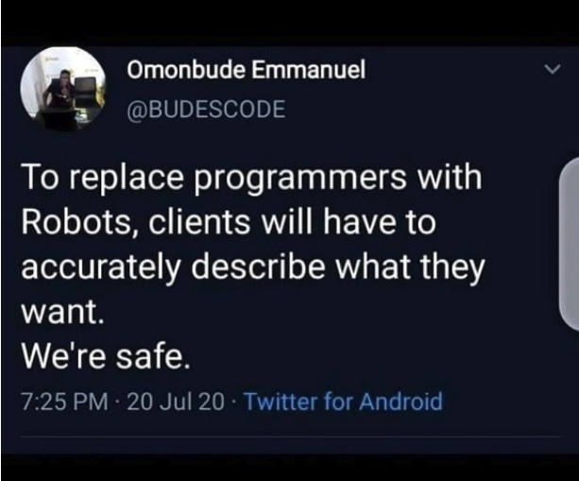
Homework Assignments
My homework assignments are:
Open ended.
Vaguely specified.
You will complain. I will listen sympathetically. My professional colleagues and I will laugh at you behind your back.
Management, clients, partners, etc.
Do not understand technology as well as we do.
You will get requirements like, “I want it colored mauve because that has more RAM.”
Converting vague requests into a useful, meaningful project that we can implement is what we do. Get over it.

Slide 20
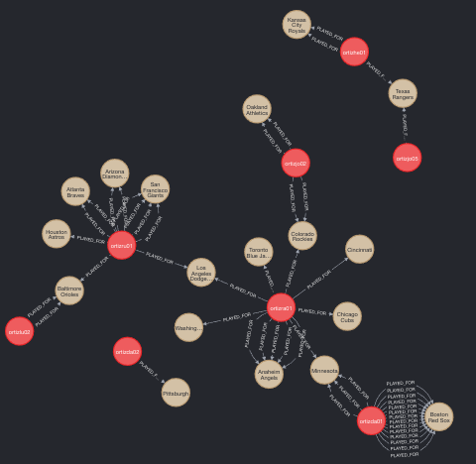
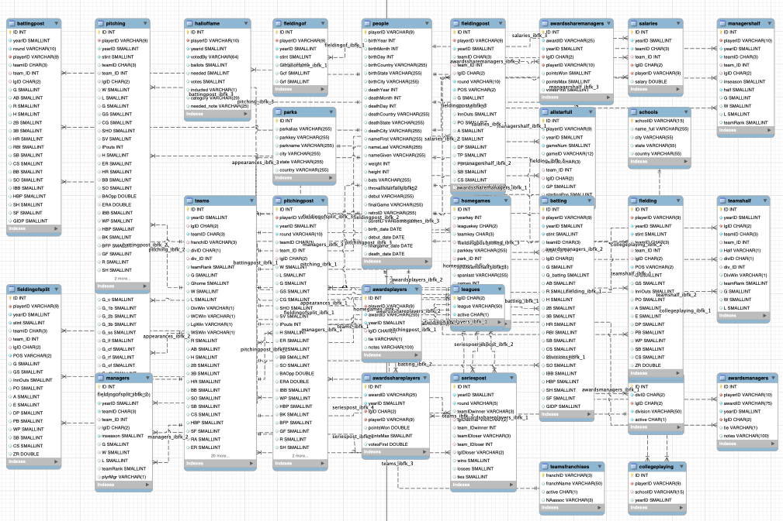
Target Application/Project

Slide 21
Core Concepts
21 | COMS W4111_002_2021_1: Lecture 1: Introduction, Course Overview, Foundational Concepts © Donald F. Ferguson, 2021

Slide 22

COVID-19 and Population Data
22 | COMS W4111_002_2021_1: Lecture 1: Introduction, Course Overview, Foundational Concepts © Donald F. Ferguson, 2021

Slide 23
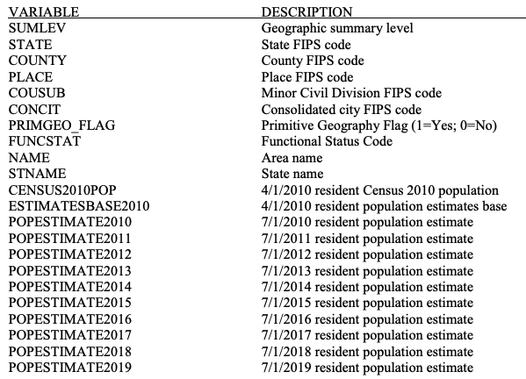
Two Sources of Information
United States Census Bureau – City and Town Population Totals: 2010-2019
NY Times Dataset
Date
County
State
FIPS
Cases
Deaths
Why two data sources? I need population to compute rates.

Slide 24
Problem 1 – Join on FIPS Codes
There are two sets of data linked by values in columns:
NY Times data FIPS column.
Census Data Place concatenation of state and county codes.
No of rows: NY Times Data – 870K, Census Data: 81K
Producing a new “table” that contains matching rows can be tricky.
I could write a program, or
There is a complicated set of instructions I can follow to accomplish in Excel.
Even if I could figure it out, it would execute slowly. There are a lot of possible matches.
It would seem that solving this problem of efficiently “joining” rows from multiple, large tables based on column values is a common problem.
It would be nice if there were something that could implement the operation in a general way for arbitrary tables.
Oh. And the Census data is by town, and I need to roll up by county. This just got harder.

Slide 25
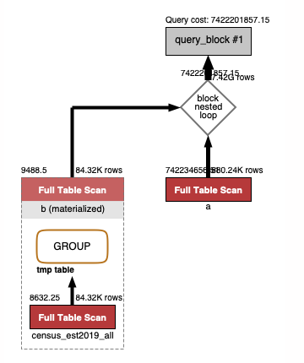
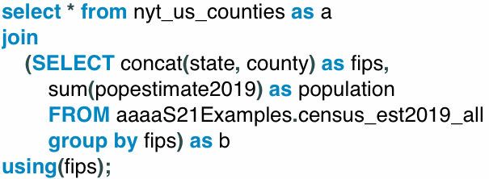
This is what Relational Databases Do.
I want
All the columns from nyt_us_counties.
Census estimates:
Concat state and country FIPS.
Group by FIPS and sum the population.
Join the two tables on FIPs.
You declare the result that you want in a special language.
The DB engine figures out how to efficiently product the result.
Basically, it write the program based on the result you declared you want.

Slide 26
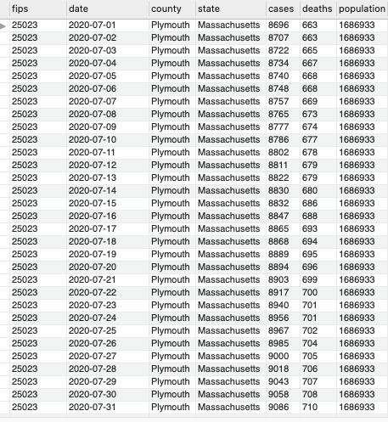
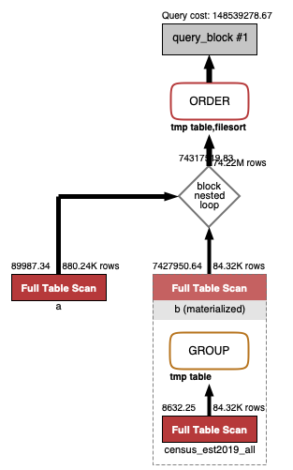
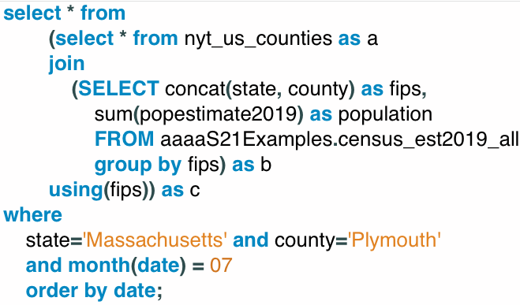
This is what Relational Databases Do.
Do what you just did, but only for
Plymouth County, MA
In July of 2020.
The relational model is an algebra.
Operations on tables produce tables, which can be operands in other queries.

Slide 27
Let’s do some hands-on work ...
Switch to Jupyter Notebook

Slide 28
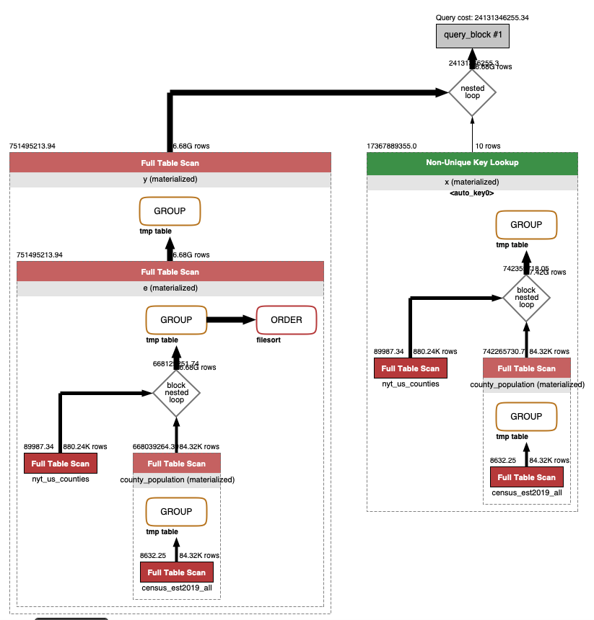
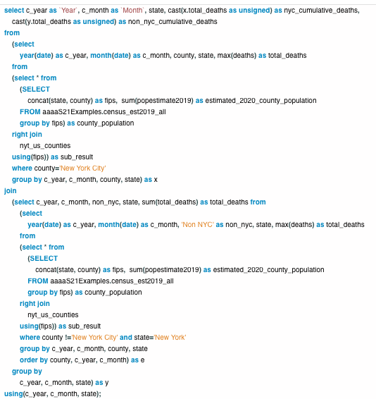
Query Engines
Database Engine
SQL seems complex. Once you learn SQL, it is more productive than hand writing code.
We will also see that the engine performs sophisticated performance optimizations.

Slide 29

Hmm. That was some dark magic, but ... ...
That was some dark magic, but what about population?
I started this example with the complexity of “JOINing” data from two tables.
COVID data.
Census population data.
Where is the analysis of “rates” based on population.
Well, it turns out the data is incomplete.
NYT COVID data has one number for NYC.
But, ... NYC is five counties.
I could not do the JOIN.
This requires me to perform Data Cleansing.

Slide 30
Data Cleansing
https://blog.amplitude.com/big-data-cleanup
Database and data science classes love to teach the fun stuff queries, data modeling, machine learning, spooky math, algorithms, ... ...

Slide 31
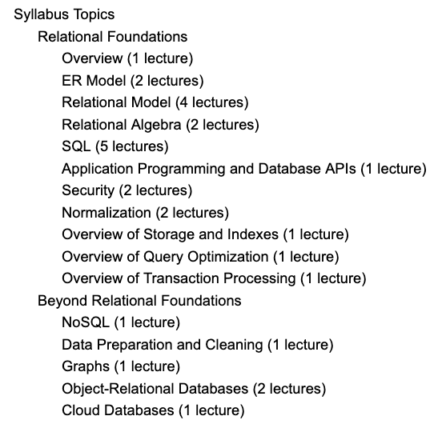
Data Cleansing
Recommended Syllabus
I place more emphasis on data cleansing and refactoring than other sections of W4111.

Slide 32
It would be nice if ..., but sadly ...
”Computer. Are there populous counties in NY not in the NY Times COVID data?

Slide 33
Let’s do some hands-on work ...
Back to Jupyter Notebook

Slide 34
Why Did You Put Us Through That?
And ...
Both programming and non-programming tracks will do work like what I just did.
The non-programming track does a lot more of it.
I know you are now afraid to ask, “But, what does the programming track have to do?”
What you learn in data science, machine learning, etc. courses.
What you learn in
this course.

Slide 35
IMDB
35 | COMS W4111_002_2021_1: Lecture 1: Introduction, Course Overview, Foundational Concepts © Donald F. Ferguson, 2021

Slide 36
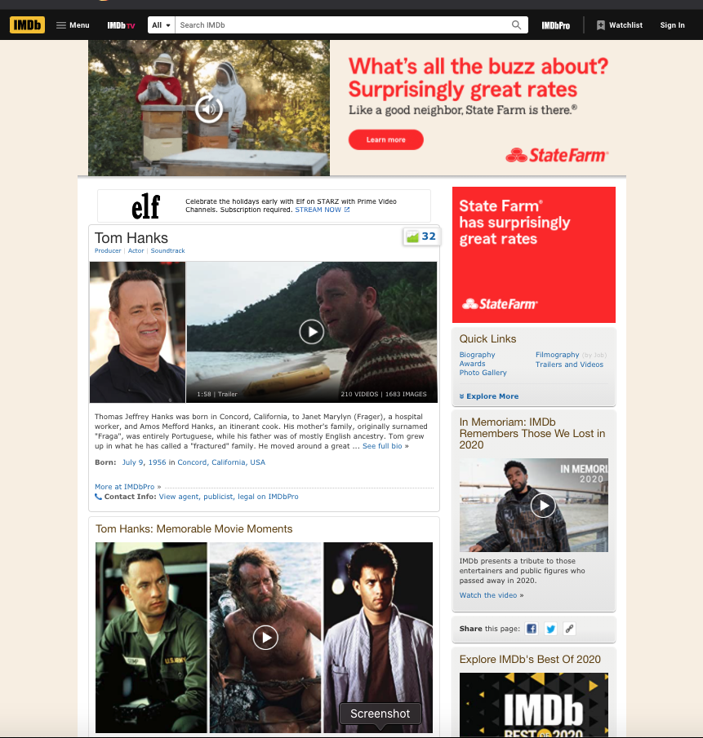
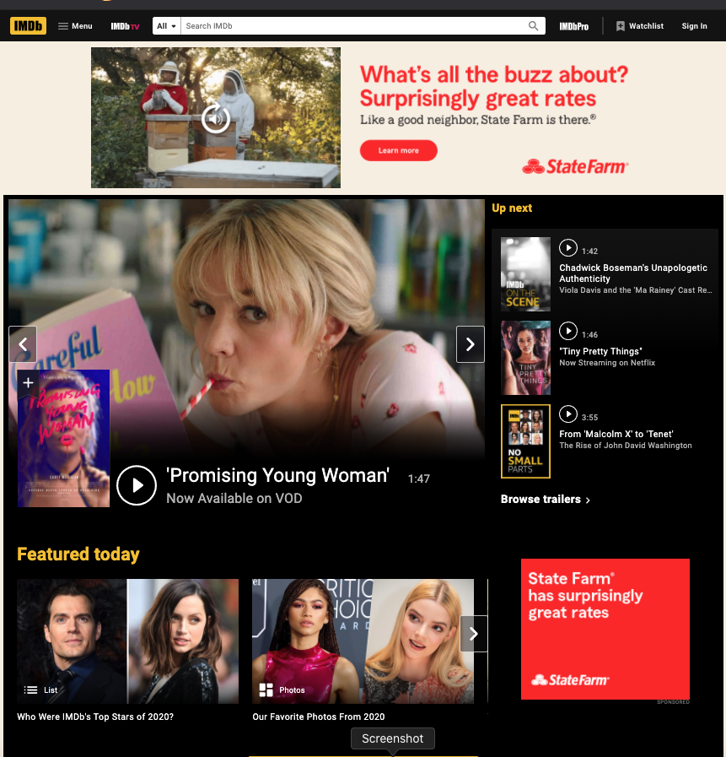
Internet Movie Database (IMDB)

Slide 37
Web Application
IMDB Database
It would be “cool” if we
could look at the data directly!

Slide 38
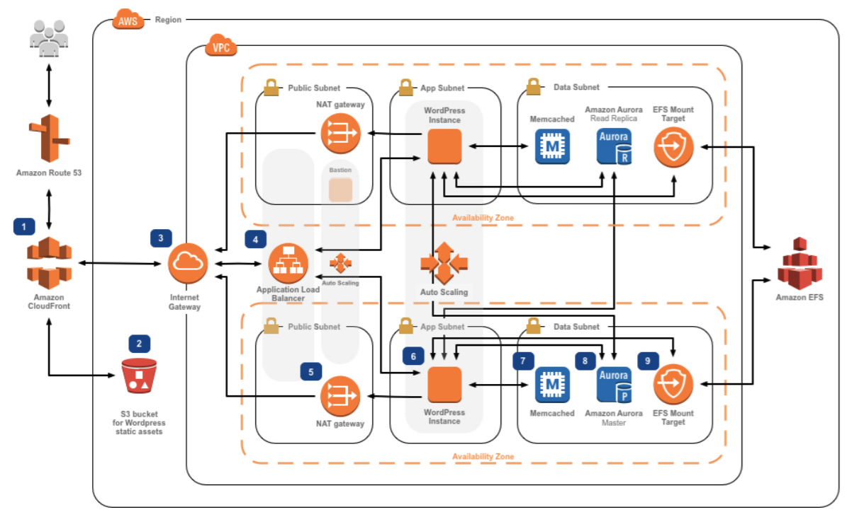
An Aside, Web Application are Complex
This is:
A trivial example.
From a tutorial.
Real solutions are staggering complex.

Slide 39
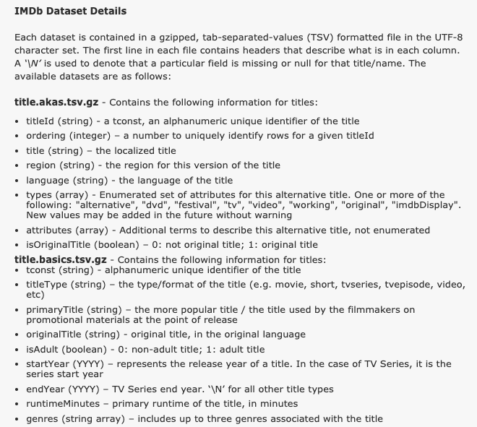
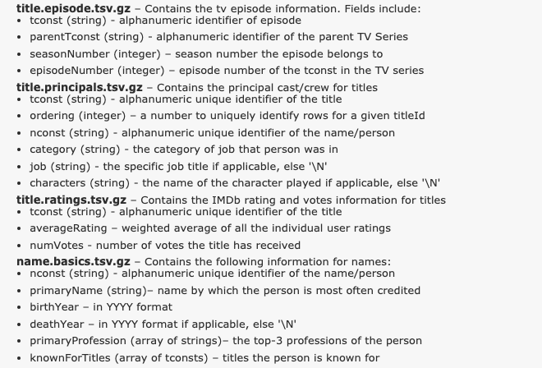
Well, we can download some of it!

Slide 40
But, ... The files are pretty big.
The uncompressed file size is about 5 GB.
Some of the files have a lot of rows:
name.basics approx. 10 million.
title.principals approx. 37 million.
There is no way I can
Open these in Excel
Let alone do my column-based joins.
And by “real world” DB standards, these files and tables are tiny.
DBs specialize in managing staggering large datasets and querying efficiently.
Applications enable users to interact with the data in meaningful ways.

Slide 41
How Does a Page Like this Work?
Well, overly simplistically ...
The web browser may a query https://www.imdb.com/find?q=%22tom+hanks
This produced the search results.
You clicked a link, and the browser made another query https://www.imdb.com/find?q=%22tom+hanks%22
The browser gets back to sets of “things.”
A page template with a bunch of slots.
Queries that determine what to put in the slots.
Based on
Context: previous queries, connections in data, ... ...
Policies: promotions, ad campaigns, ... ...
User info: prior queries, location, language, ... ...
... ...

Slide 42
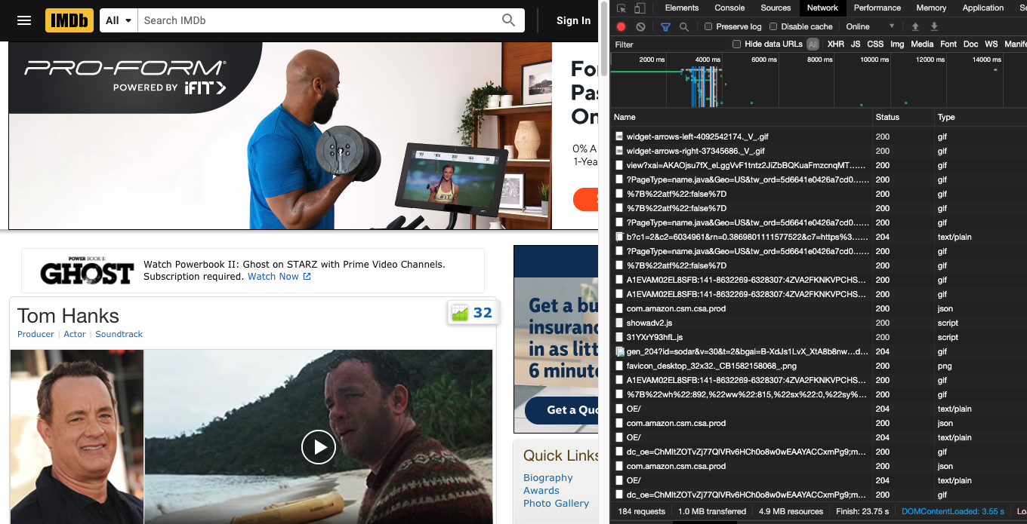
How Does a Page Like this Work?
One look up https://www.imdb.com/name/nm0000158 ==> 183 other look ups.

Slide 43
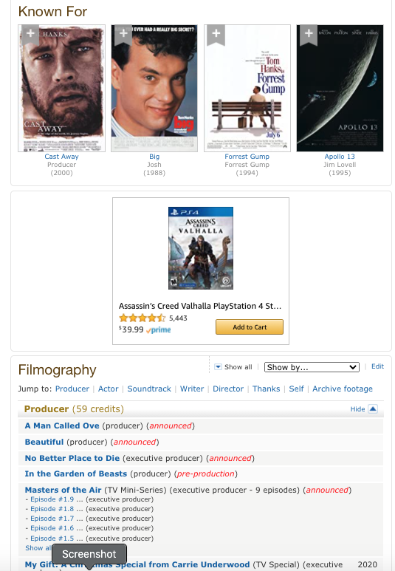
How did I Know this Information?
The core is answering 4 questions.
“Tom Hanks’” ID in my system is nm0000158
nm0000158 is known for:
tt0094737
tt0109830
tt0162222
nm0000158 had some kind of role in
tt0080202
tt0084314
tt0086927
tt0088161
tt0089543
tt0090274
tt0091019
tt0091541
tt0091653
... ...
The ability to turn ttxxxxxxx into useful information.

Slide 44
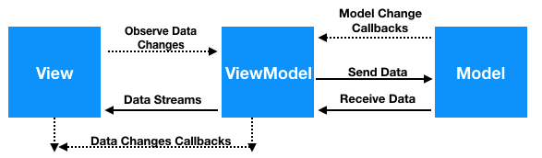
How this all Work?
There is a page
template with slots for “components”
W4170 teaches:
Page design
View
ViewModel
User experience
...
W4111 teaches
Model
Efficiency, design
... ...
HTML CSS
API Calls Data
JavaScript

Slide 45
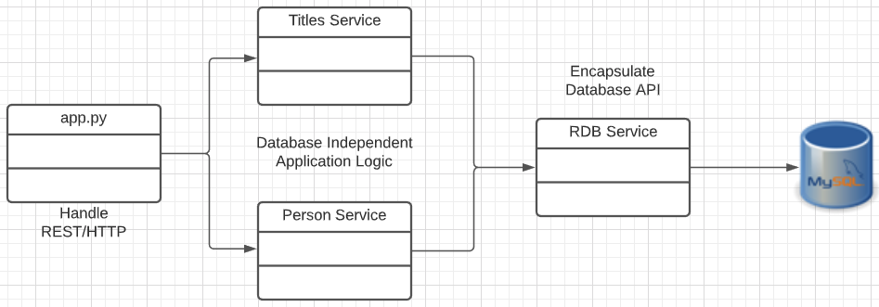
A Simple IMDB-Like Web Application
Downloaded Files
Browser
Display
Modified Angular Tour of Heroes Sample
https://angular.io/tutorial
Content/Code in browser
Load
Python Flask
HTTP/REST
Network
SQL Queries
Three components
Main application
People Dashboard
People Detail
One service: People
Very simple Python, Flask web application
https://flask.palletsprojects.com/en/1.1.x/

Slide 46
Let’s take a look ... ...
Browser.
Code walkthrough.
Some simple tests.

Slide 47
Backup

Slide 48
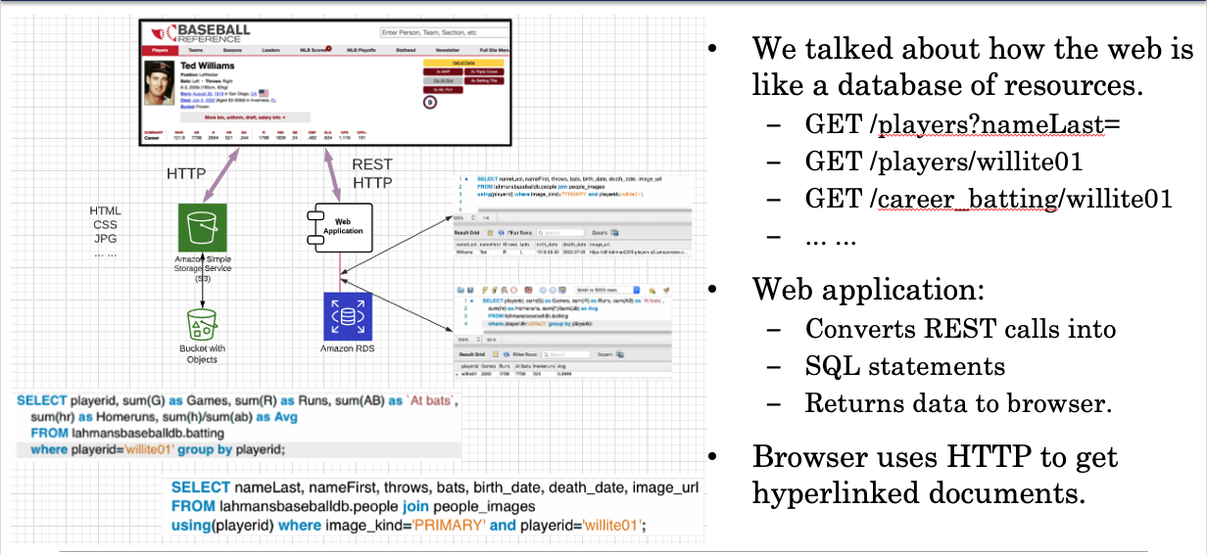
How Does This Work ...

